Slide 1
LIBRARY MANAGEMENT SYSTEM Capstone Project Full Stack Web Development
Rajagopal Ramesh
28-03-2025

Slide 2
Overview
User login and new user sign-up home page
Book Borrow and Return Facility
If overdue, highlight to the users
User can not able to borrow same book again
User can not borrow more than 3 books
Track due dates

Slide 3
Purpose
To provide a friendly environment to maintain the details of books and library members.
To maintain the circulation system using computers and to provide different reports.
Improved customer service through greater access to accurate information.
Greater accountability and transparency in operations.

Slide 4
Scope
Provides user to search by
Title
Author
ISBN
All the records can be saved at the MYSQ

Slide 5
Requirements
Register User if new
Login Page
Book Search ( Title, Author, ISBN)
Book Issue: This module is used to keep the track of book issue details.
Book Return: This module enables to keep a track of returned books.
Check overdue
Check the fine amount

Slide 6
Non Functional Requirements
Wrong password to be prompted
Empty password should be prompted
If user tried more then 3 books to borrow , should be prompted
If the user tried to borrow same book again then the UI should show message.
Development Requirement
Backend: Spring Boot, RESTful API, MySQL, Spring Security, JPA/Hibernate.
Frontend: React.js, React Router, React Hooks, Bootstrap/Material-UI, Axios.
Database: Proper relationship mapping, referential integrity, indexing, data validation.

Slide 7
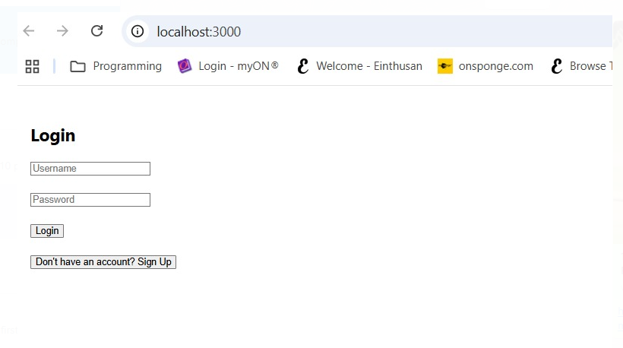
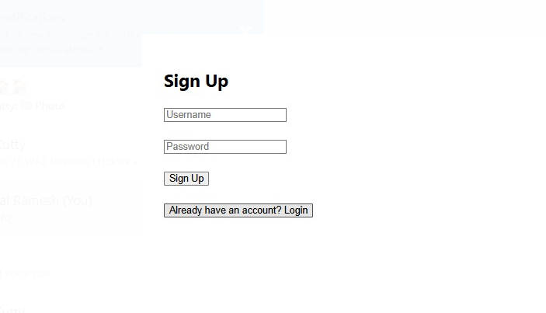
Login page

Slide 8
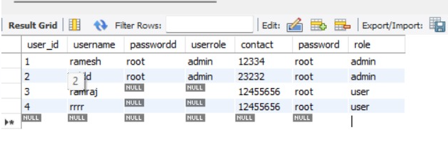
Signup Page
User Table

Slide 9
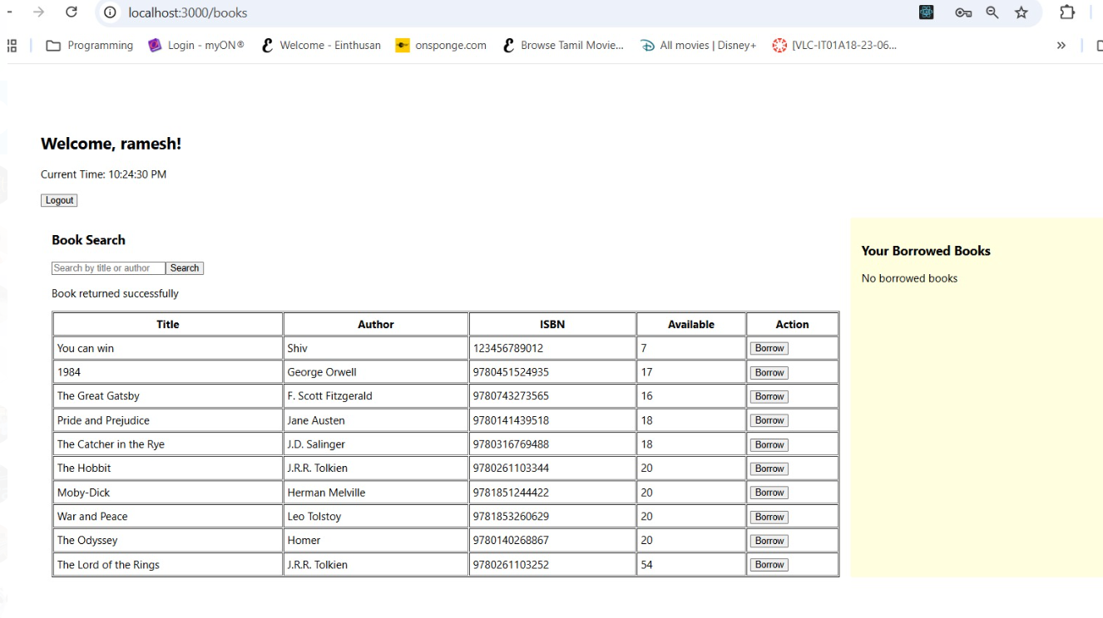
Search & Borrow

Slide 10
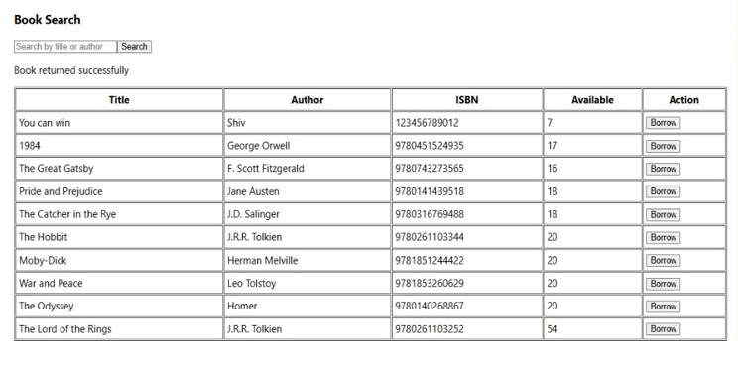
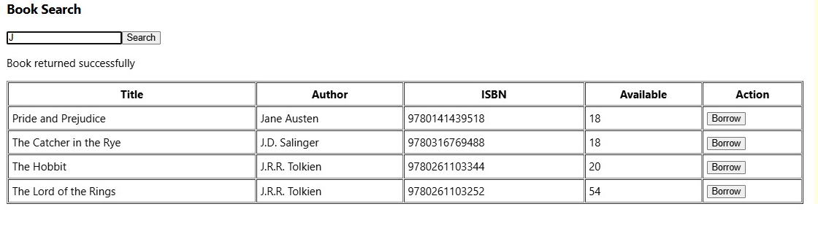
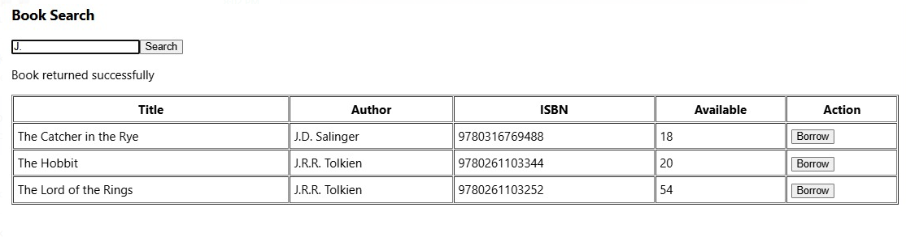
Search

Slide 11
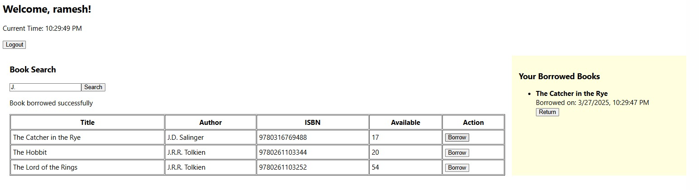
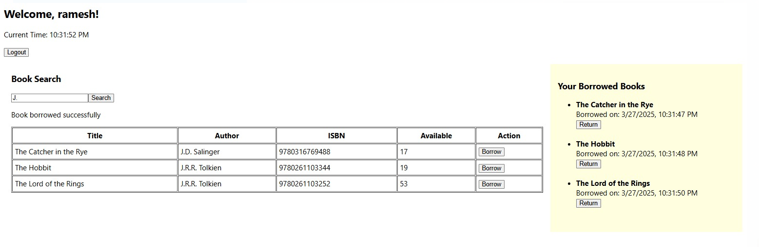
Borrow

Slide 12
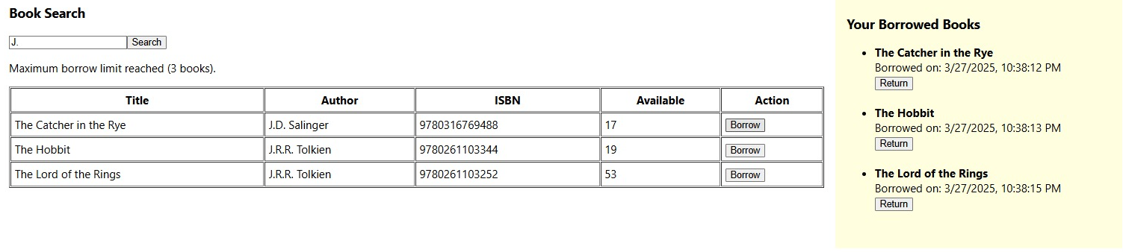
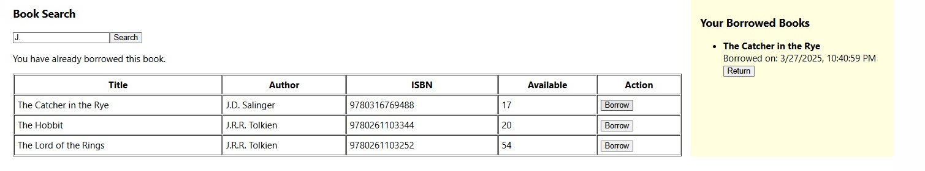
Borrow- Rules

Slide 13
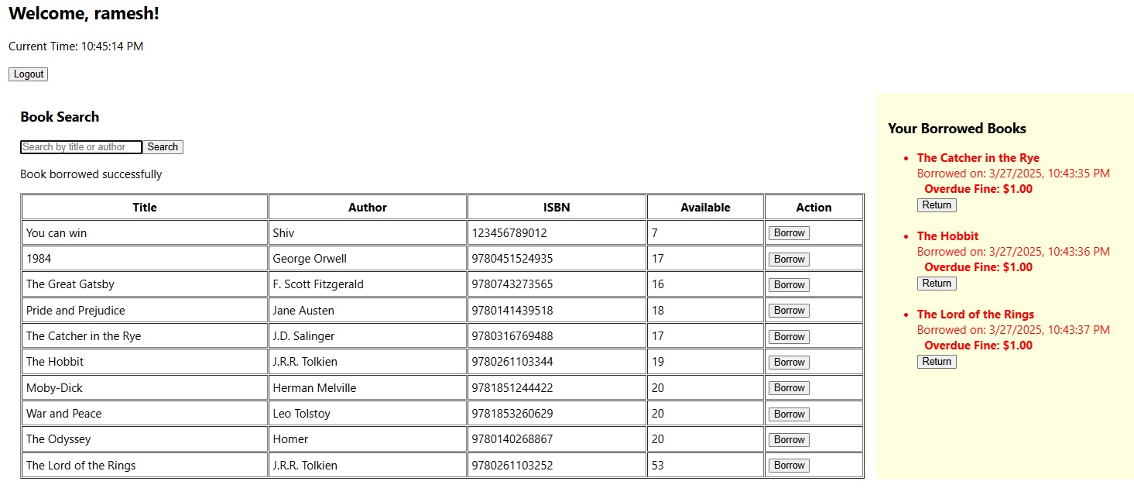
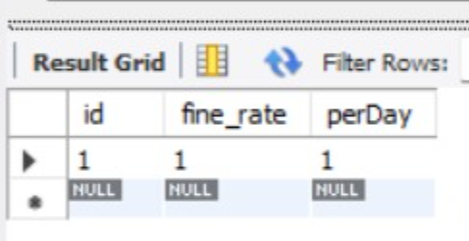
Overdue
Configurable Fine Rate:

Slide 14
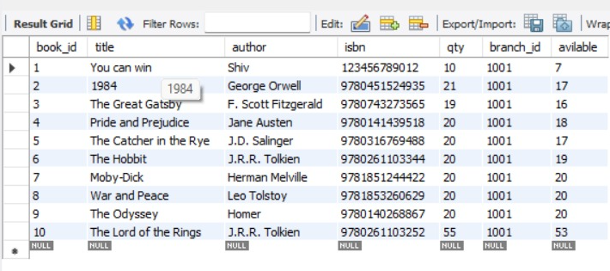
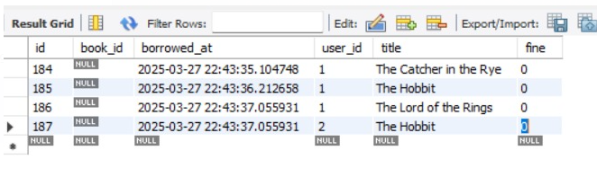
Database Links
Book Table
Borrowed
Book Table

Slide 15
Conclusion
User scenarios were tested with the business rules.
MySQL database designed such a way that future fine-rates can be configured without the need of code change
Admin User functionality need to improved.

